Slide 1
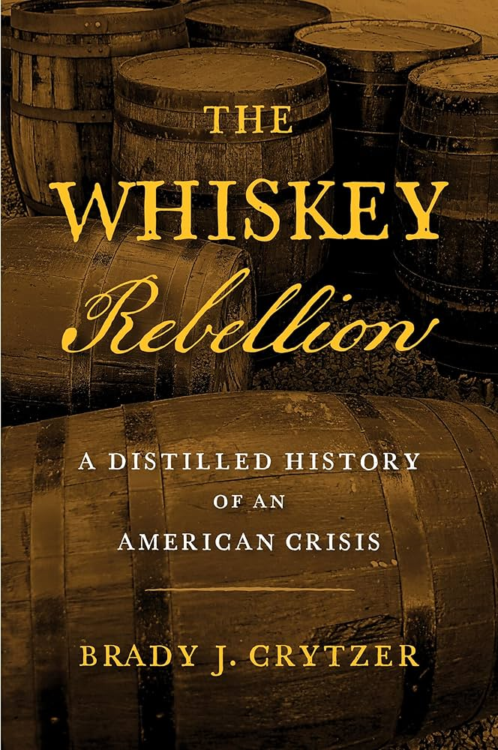
The Whiskey Rebellion
A Distilled History of an American Crisis

Slide 2
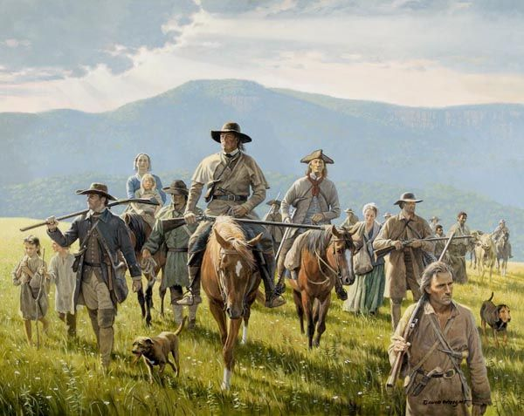

Slide 3
How to Raise Money
Hamilton believed that he had raised taxes as high as possible on imported goods
Now sought an Excised tax on Whiskey
Believed whiskey to be a Luxury Good
Sought believed that he would earn the support of Social Reformers as well
Whiskey Act became law in March, 1791

Slide 4
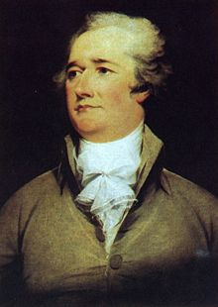
The National Debt
The New Federal Government also had to deal with the issue of debt
Secretary of Treasury Alexander Hamilton devised a plan to consolidate individual state debts
Devised a plan of taxation to accrue additional funds

Slide 5
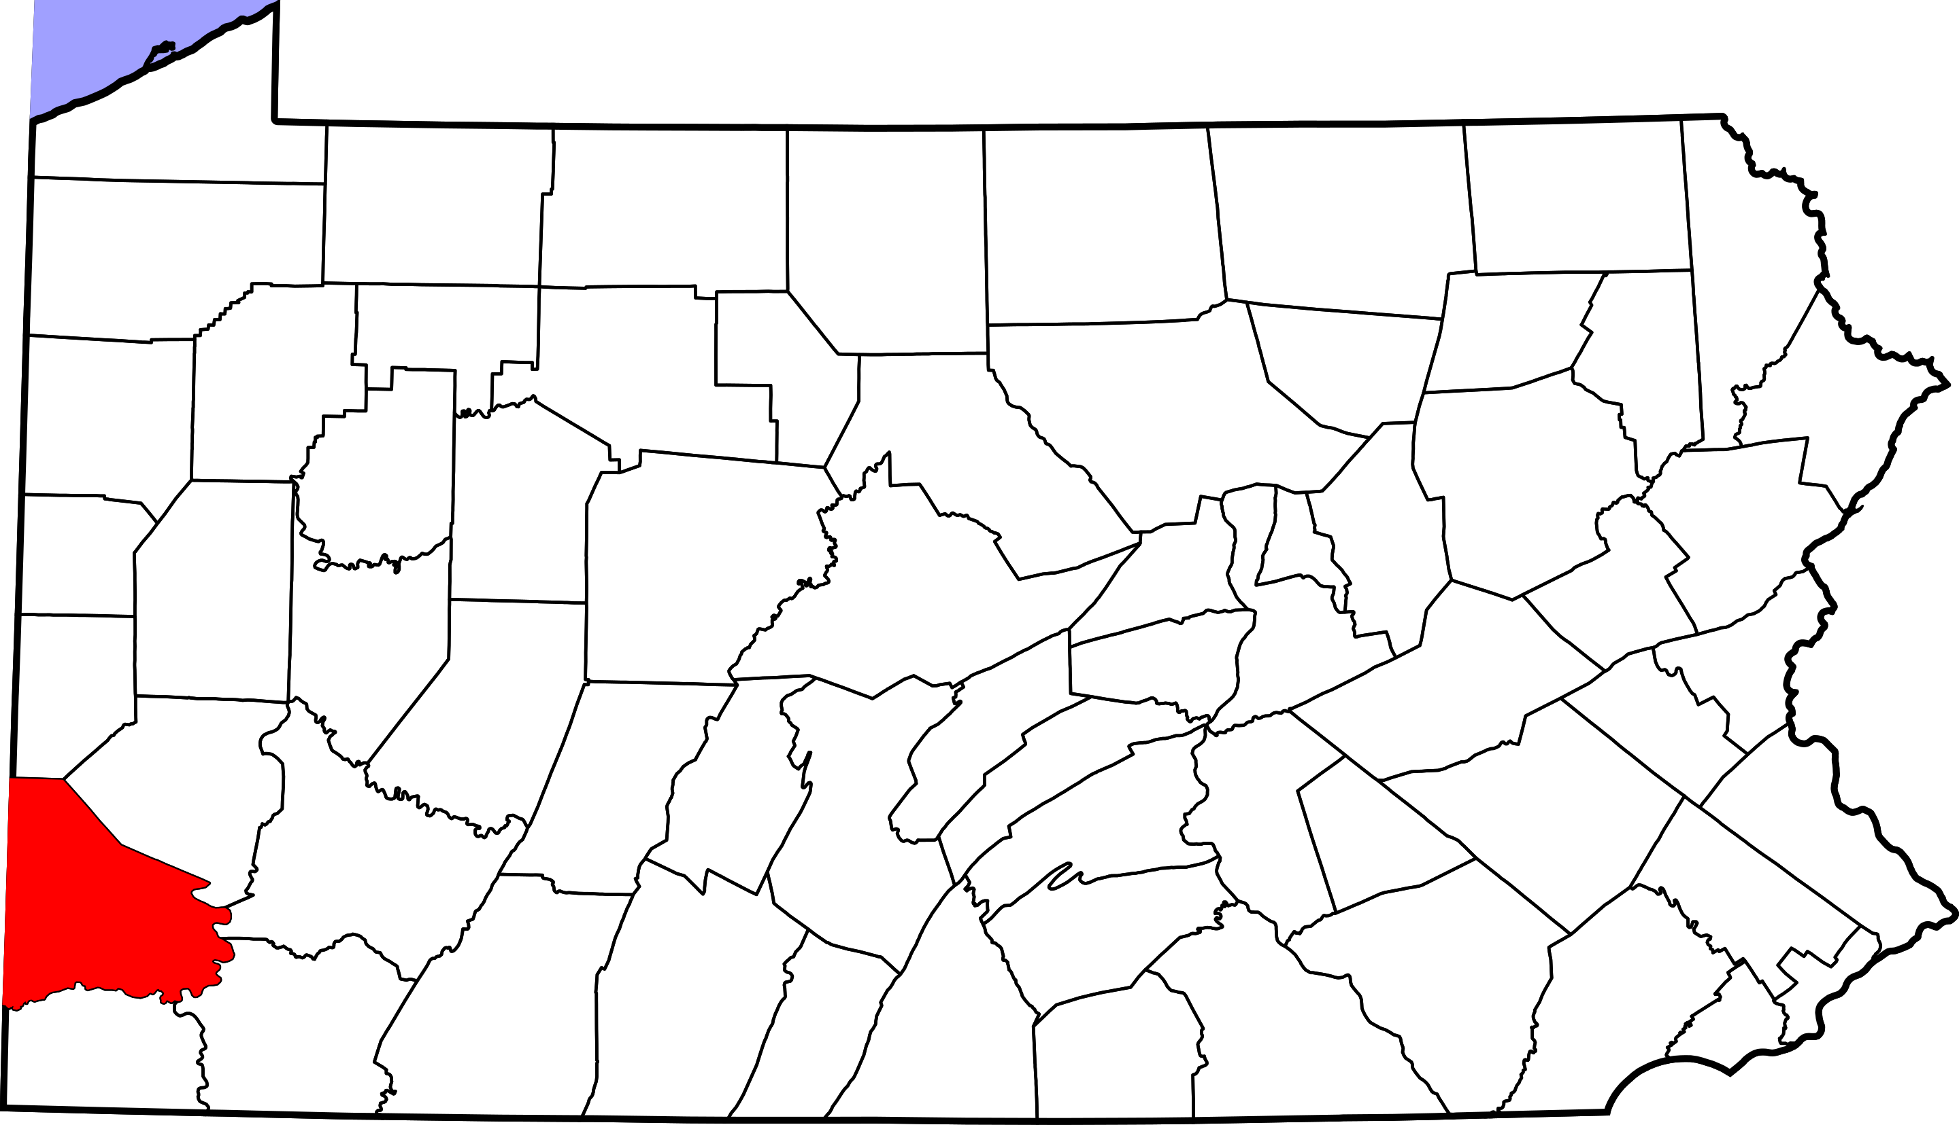

Slide 6
Dismay on the Frontier
While most major whiskey distillers in the East produced enough wealth to negotiate this tax
Many Westerners did not
Farmers of Western PA grew corn
This corn was distilled into Whiskey and sold east
Westerners believed that this tax was created to deliberately make them non-competitive
Essentially an Income Tax

Slide 8
Opposition
Opposition to the new tax was strongest in Southwestern counties
Fayette
Westmoreland
Washington
Allegheny
A council met in Fayette County to collect their grievances and petition the Pennsylvania Assembly

Slide 9
Opposition
The Federal Government reduced the tax by one cent
Soon open riots were occurring
Tax Collector Robert Johnson was tarred and feathered
The Whiskey Tax went largely uncollected due to these violent outbursts
In 1792, Hamilton advocated military action to suppress violent resistance
Attorney General Randolph disagreed
Lack of evidence to justify it

Slide 10
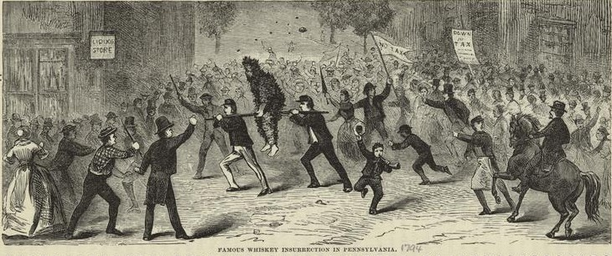
John Neville
Federal Tax Collector for Western PA
Former Revolutionary War General
Rented a room in Pittsburgh for his tax office
Was targeted by Whiskey Rebels
Burned likenesses of him in front of crowds
Washington County, 1793

Slide 11
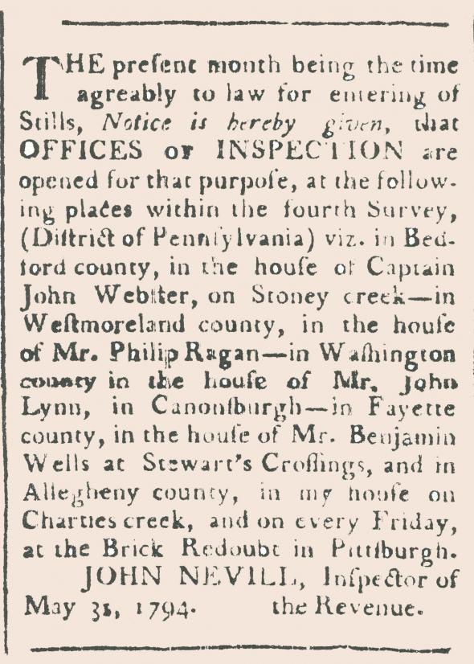

Slide 12
Subpoenas, May 1794
William Rawle, Federal District Attorney
Issued subpoenas for 60 farmers who had not paid the tax
Required farmers to travel to Philadelphia to face a federal court
Western PA politicians were able to sway Congress
Trials could be held in local courts
By that time US Marshall David Lenox had already been sent to serve writs of summons however
Many cried foul

Slide 13
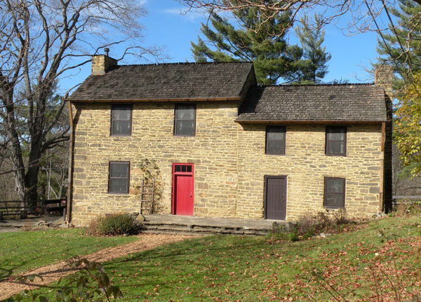
Lenox
Lenox was able to issue most of his writs without any incident
He would be joined by John Neville as a guide
He would be fired upon at Miller’s Farm
Bethel Park, PA
Lenox would retreat
to Pittsburgh

Slide 14
Bower Hill, Day One
The following day, rebels surrounded the homestead of John Neville
Bower Hill
Many believed that Lenox was inside
The rebels opened fire on Bower Hill
Neville responded firing one shot
Killed Rebel Oliver Miller
The Rebels retreated to Couch’s Fort to gather reinforcements

Slide 15
Bower Hill, Day 2
Neville’s homestead was also reinforced by ten soldiers of the U.S. Army
Under command of Major Abraham Kirkpatrick
Neville himself was instructed to flee
Soon a rebel force of over 600 surrounded Bower Hill again
Under the “command” of Revolution Veteran James McFarlane
The groups exchanged fire

Slide 16
The Burning of Bower Hill
Soon the rebel leader McFarlane called a cease-fire
Many claim that a white flag was seen waving from the home
As McFarlane approached Bower Hill, he was shot dead by someone inside
The Rebels exploded in rage and burned the estate to the ground

Slide 17
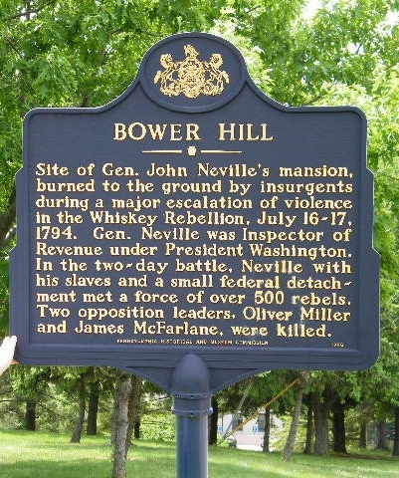

Slide 18
Rebel Response
Whiskey Radicals like Washington County Lawyer David Bradford now took center stage
Bradford lead a movement in Pittsburgh that intercepted mail to find those he deemed as traitors
Finding several letters condemning the Radicals, Bradford called for a meeting on Braddock’s Field
There were clear plans to march on Pittsburgh and burn it down

Slide 19
Meeting at Braddock’s Field
At Braddock's Field, there was talk of declaring independence from the United States
Possibly joining with Spain or Great Britain.
Radicals flew a specially designed flag that proclaimed their independence.
The flag had six stripes
one for each county represented at the gathering:
five Pennsylvania counties (Allegheny, Bedford, Fayette, Washington, and Westmoreland)
One Virginia county (Ohio County)

Slide 20
Pittsburgh's’ Response
Pittsburgh citizens helped diffuse the threat
banishing three men whose intercepted letters had given offense to the rebels
sending a delegation to Braddock's Field that expressed support for the gathering.
In Pittsburgh, only the barns of Major Kirkpatrick were torched.

Slide 21
Washington’s Debate
Washington needed to confront the rebels
Did not want to alienate public opinion
Cabinet members urged military action with the exception of Sec. of State Edmond Randolph
Before troops could be raised, the Militia Act of 1792 required that a justice of the United States Supreme Court certify that law enforcement was beyond the control of local authorities.

Slide 22
Washington’s Decision
On August 4, 1794, Justice James Wilson delivered his opinion
Western Pennsylvania was in a state of rebellion.
On August 7, Washington issued a presidential proclamation
Announced with "the deepest regret", that the militia would be called out to suppress the rebellion.
He commanded insurgents in Western Pennsylvania to disperse by September 1

Slide 23
Armed Forces March to Pittsburgh
Militia units would venture to Pittsburgh from NJ, VA, PA, and MD
As forces marched towards Pittsburgh, President Washington would meet with military officials at Bedford, PA
The first and only time that a standing US President led forces in the field as Commander-in-Chief

Slide 24
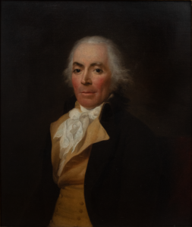
New Jersey Governor Richard Howell
“To arms once more, our hero cries, Sedition lives and order dies; To peace and ease then bid adieu And dash to the mountains, Jersey Blue.”
“Brothers, you must not think to frighten us with fine arranged lists of infantry, cavalry, and artillery, composed of your watermellon armies from the Jersey shores; they would cut a much better figure in warring with the crabs and oysters about the Capes of Delaware.”-Pittsburgh Gazette

Slide 25
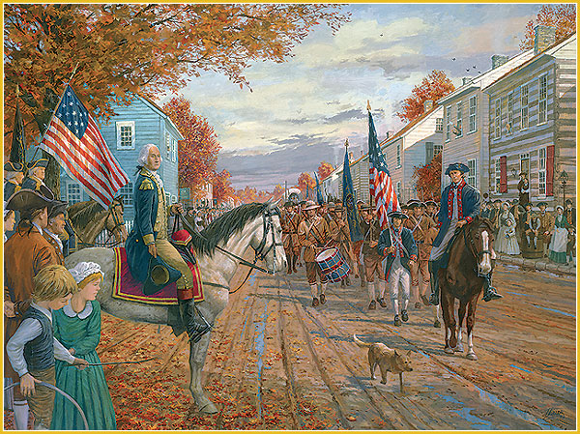

Slide 26
The Rebellion Collapses
The insurrection collapsed as the army marched into western Pennsylvania in October 1794.
Some of the most prominent leaders of the insurrection fled westward to safety.
David Bradford among them
Federal government officials arrested about thirty people and brought them back to Philadelphia for trial.

Slide 27
Legacy of Rebellion
The Washington administration's suppression of the Whiskey Rebellion met with widespread popular approval
The episode demonstrated that the new national government had the willingness and ability to suppress violent resistance to its laws
It was therefore viewed by the Washington administration as a success, a view that has generally been endorsed by historians.

